Slide 1
Spoken language detection.
Bhaskar Sharma

Slide 2
Data preparation
Dataset used: https://www.kaggle.com/datasets/toponowicz/spoken-language-identification
Audios converted from FLAC to Wav using FLACtoWav.py (external library needed).
Create CSV using CreateCSV.py.
(In case of dataset reduction) ReduceDataset.py

Slide 3
Data format
26000 audio files evenly divided between 3 languages.
Different fragments, also with their noise, pitch adjustment, speed adjustment.
About 16 GBs of dataset.

Slide 4
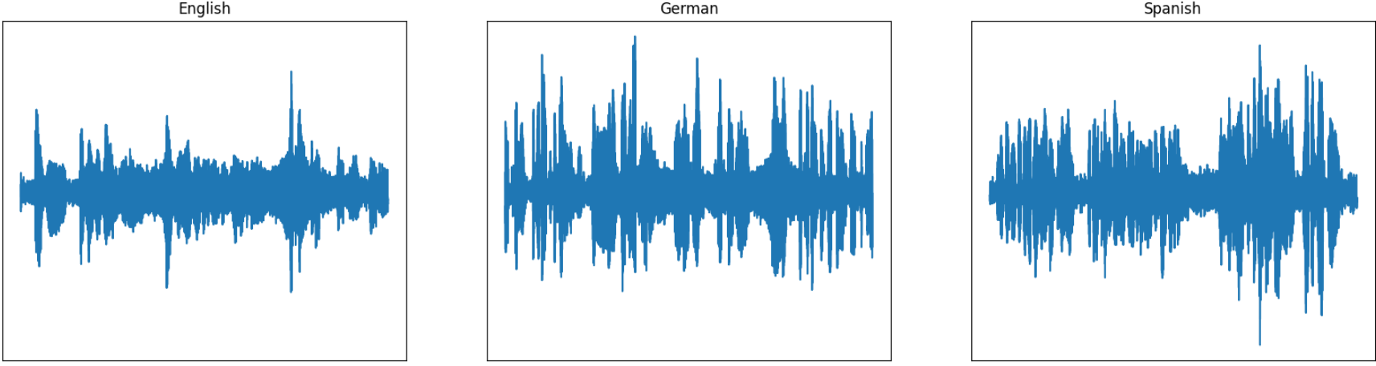
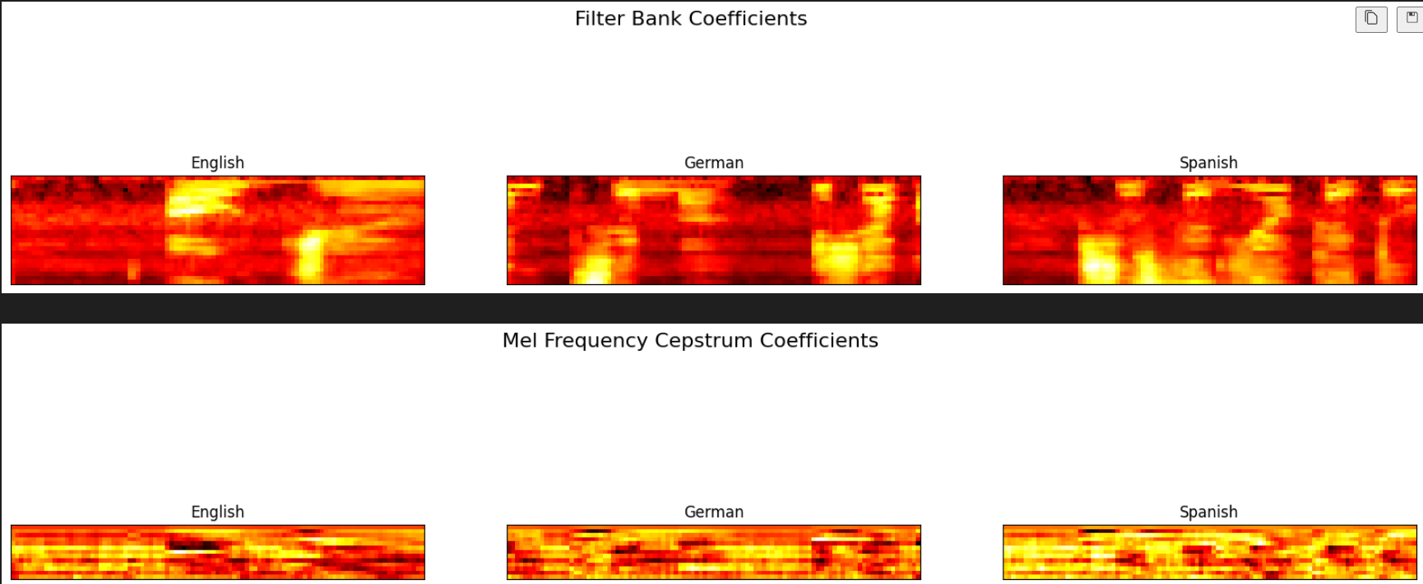
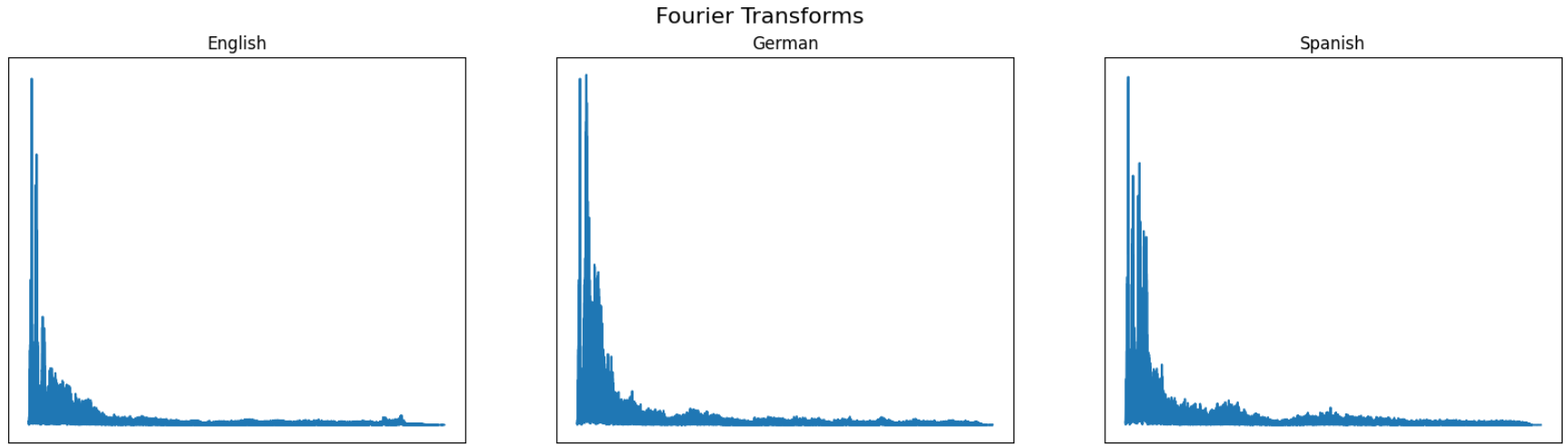
Data analysis
Various features of audio files are first computed and analyzed. Such as: FFT, filter bank, MFCCs

Slide 5
Data processing
We randomly select audio files and segments.
Extract the MFCC features
Normalize the features

Slide 6
Model preparation
Four convolutional layers with increasing filter sizes.
A max pooling layer followed by a dropout layer.
A flattening layer to convert the 2D data to 1D.
Two (dense) layers for feature extraction.
An output layer with softmax activation for multi-class classification.
The model is compiled with categorical cross-entropy loss and the Adam optimizer, and it evaluates performance using accuracy.

Slide 7
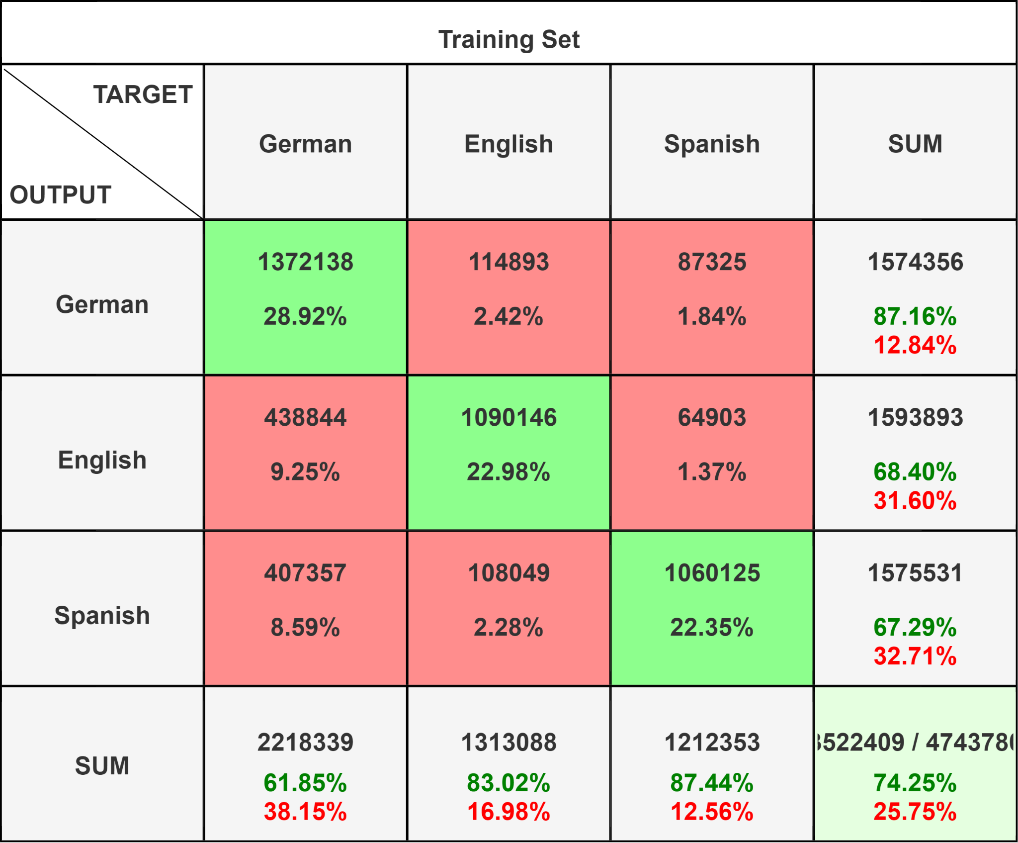
Results

Slide 8
Hypothesis

Slide 9
Further work needed

